Slide 1
URL: https://www.pavesini.it/

Slide 2


Slide 3
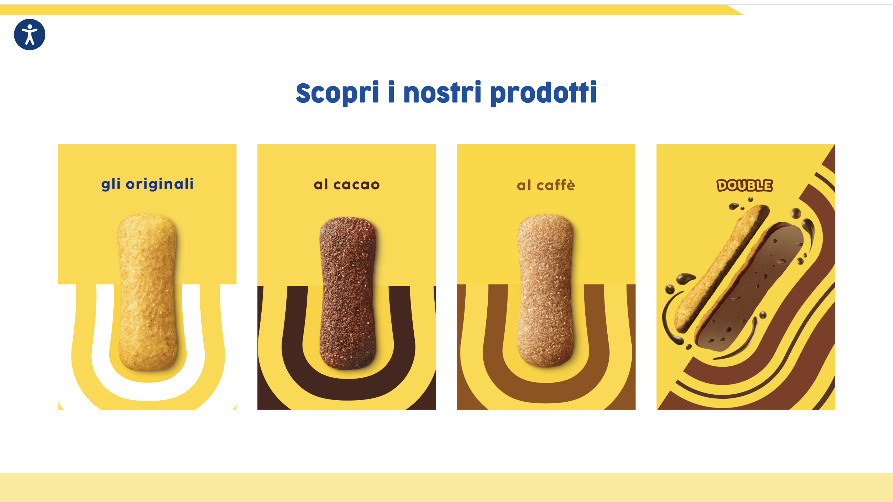

Slide 4
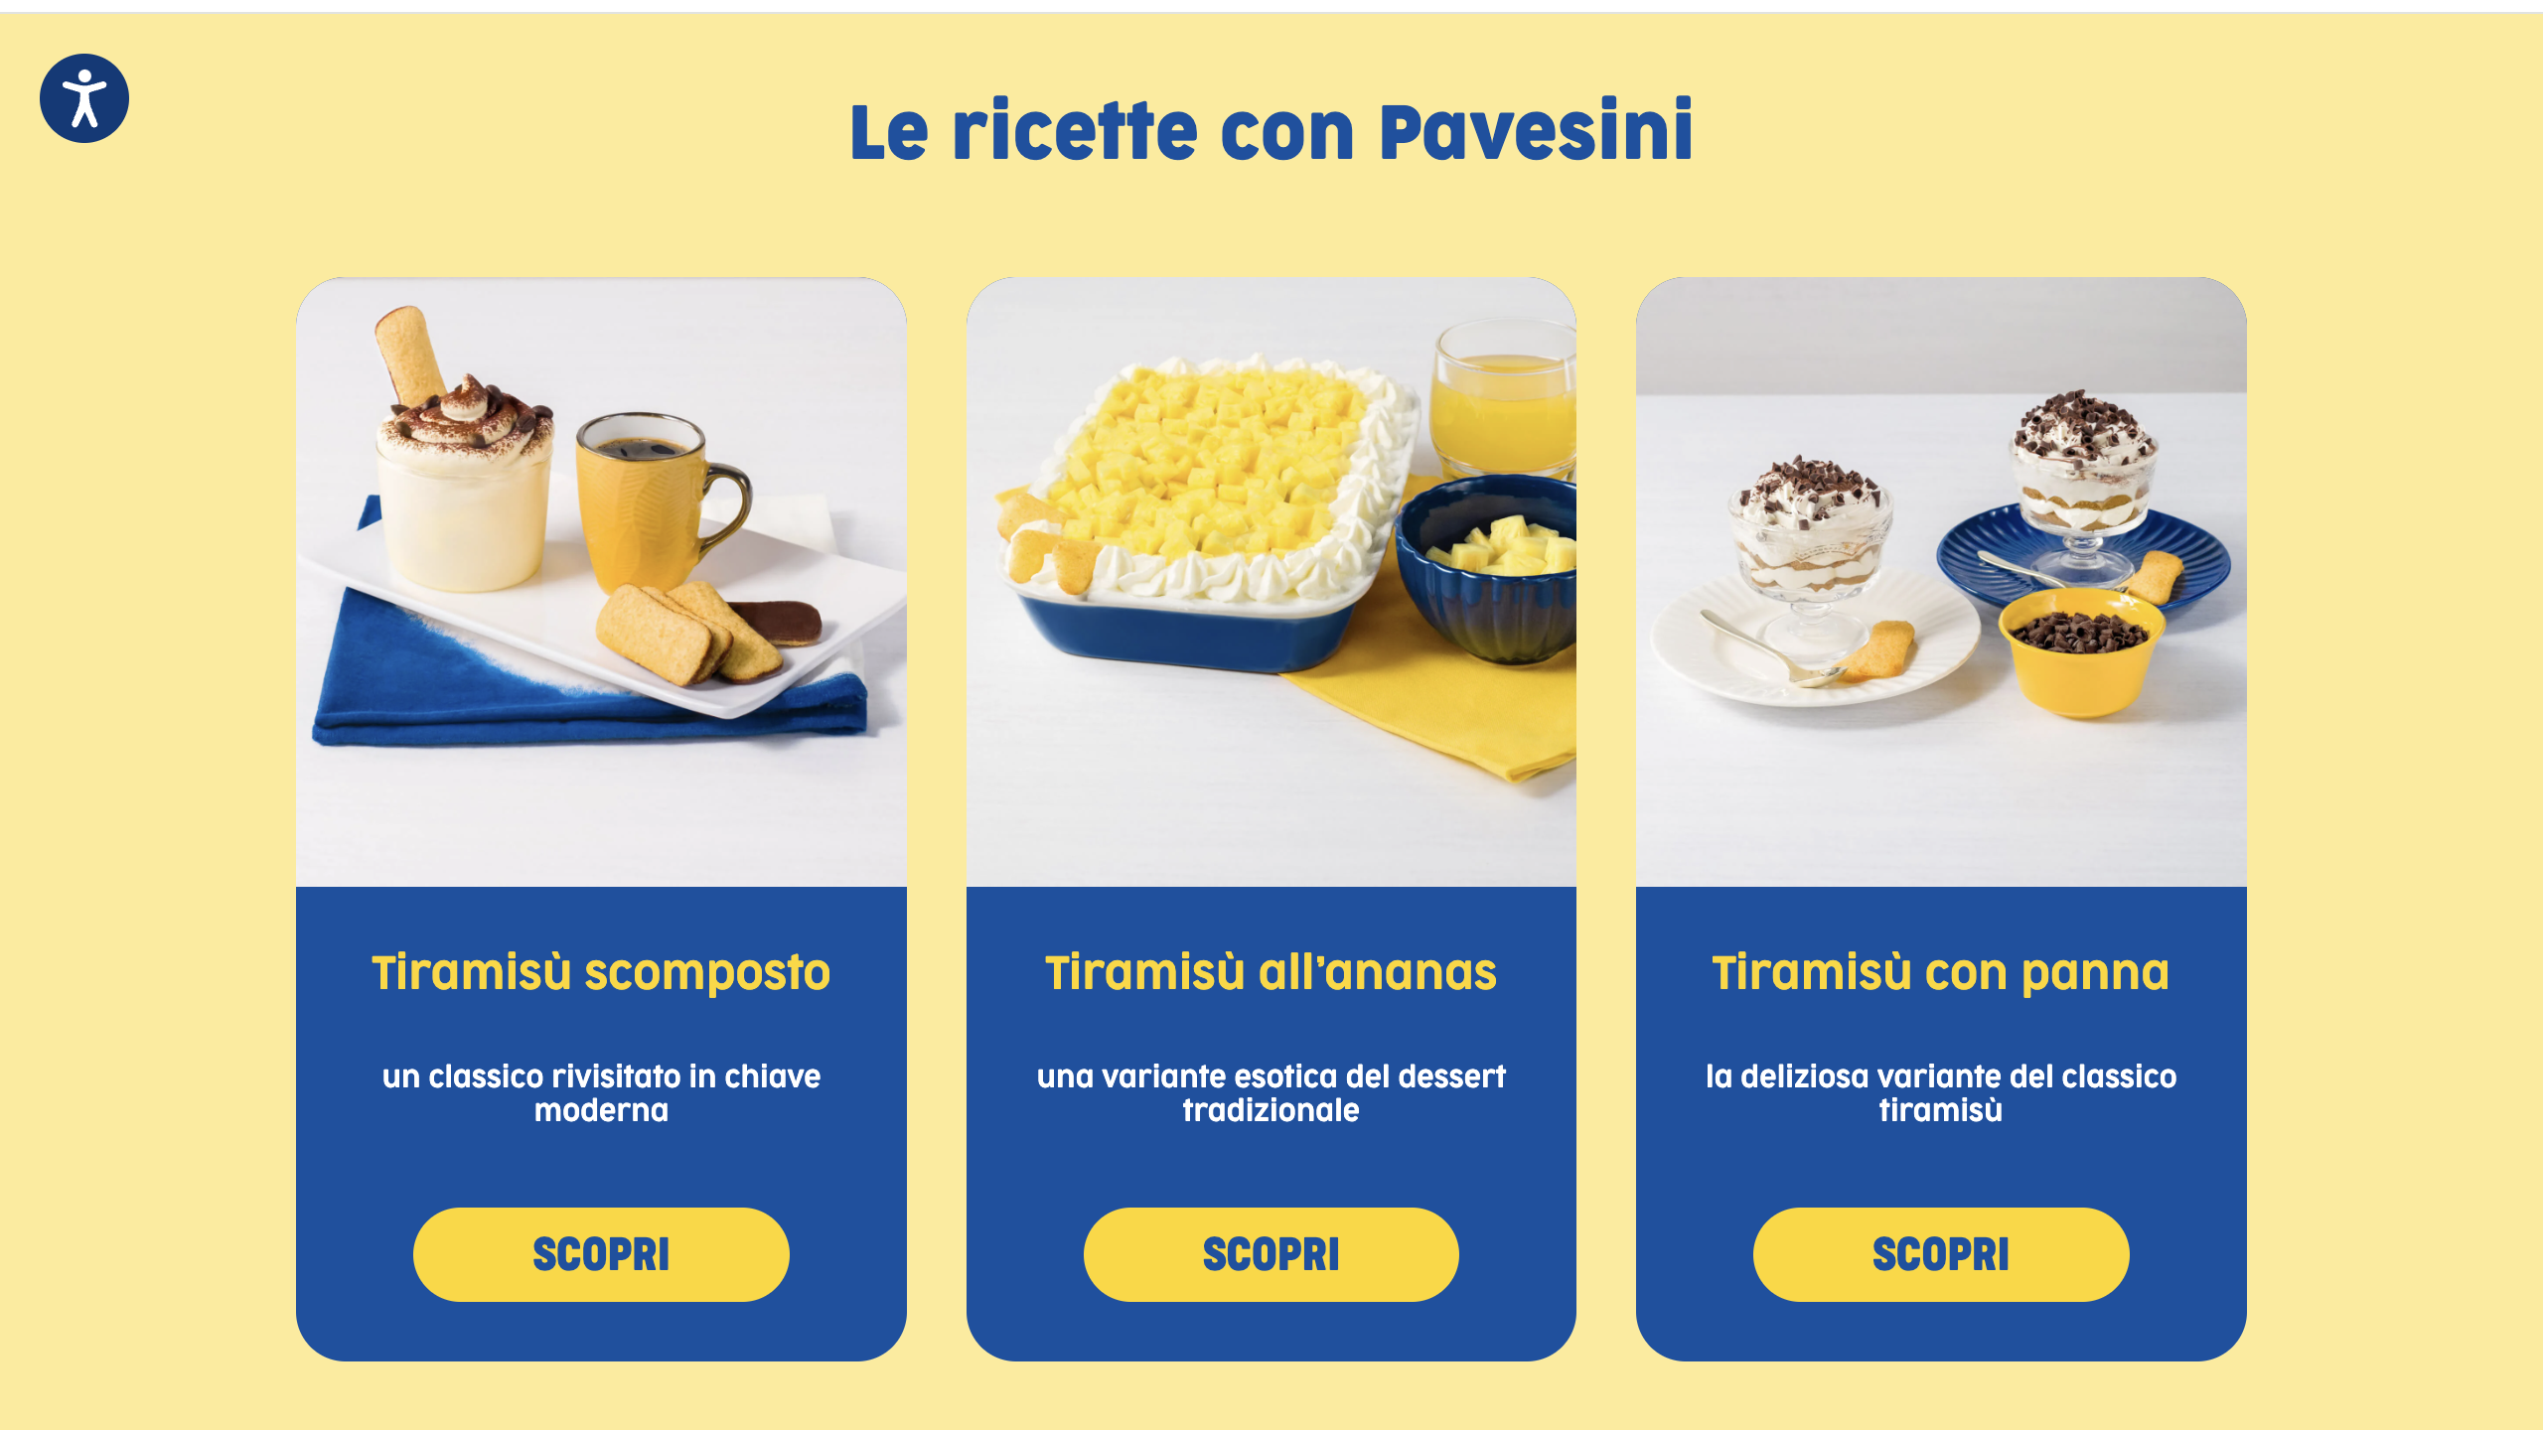

Slide 5
